Slide 1
DTSC 5082 - Seminar in Research and Research Methodology
Group- 4
Sai Krishna Thode - 1158931
Kishan Suwal - 10821032
Joshnavi Chenreddy - 11591842
Ashwitha erabelly - 11591750

Slide 2
Advancing Tennis Match Outcome Prediction
Predicting the result of Long Tennis game using Machine learning and historical data

Slide 3
Agenda
Title
Introduction and Background
Problem Statement
Literature Review
Objectives
Data Collection and Research Design
Exploratory data analysis (EDA)
Data Analysis
Data Analysis and Model Description
Data Visualization and Results
Conclusion
References

Slide 4
Introduction and background
Tennis, a sport celebrated for its intensity and unpredictability, captures the imagination of fans worldwide.
However, predicting match results accurately is a tough challenge, crucial for both and moreover fans seeking insights and betting markets making informed decisions.
Traditional methods of match prediction depends heavily on subjective analysis and expert opinions, usually it is needed to consider the multitude of factors influencing outcomes.
The emergence of data science provides a new avenue to deal with different type of datasets and find out hidden patterns. By using machine learning and historical data, we have the potential to redefine tennis match prediction, offering more accurate forecasts than ever before.

Slide 5
Problem Statement
The core problem revolves around accurately predicting the winners of tennis matches, which is important for fans and for betting markets as well
Despite the expertise of analysts and subjective insights, traditional methods often fall short due to the complexity of factors influencing match outcomes.
External variables such as player skill, tournament conditions, and even physical attributes can sway the result, making prediction challenging.
By using data science techniques, particularly machine learning algorithms and historical data analysis, we aim to address this challenge and develop models that can predict match winners with higher accuracy.

Slide 6
Literature Survey
Yue, Chou, Hsieh, and Hsiao (2022) explores deeper into the application of the Glicko system specifically for tennis matches. This model, rooted in rating players based on their performances and the quality of opponents faced, offers a structured framework for predictive analytics in tennis highlighting the potential of the Glicko model to enhance decision-making processes in tennis-related domains.
Herbinet (2018) emphasized the potential of machine learning algorithms in forecasting football outcomes, highlighting the importance of features such as team performance and match conditions.

Slide 7
Literature Survey
Joseph, Fenton, and Neil (2006) utilized Bayesian nets and other machine learning techniques, showcasing the effectiveness of probabilistic models in finding complex relationships between team performance & match conditions.
Prasetio (2016) focused on logistic regression for predicting football match results, estimating the likelihood of different outcomes based on historical data.

Slide 8
Literature Survey
Baboota and Kaur (2019) examined predictive analysis and modelling of football results using machine learning, particularly in the English Premier League, highlighting the importance of feature selection and model optimization. Additionally,

Slide 9
Objectives of the Study
The main objective of the study is to use machine learning techniques and historical data to develop accurate predictive models for tennis match outcomes by using better feature selections and using hyper tunning as suggested by Yue, Chou, Hsieh, and Hsiao in his study. Main aim is to increase our understanding of the complex dynamics of tennis matches and provide valuable insights for fans and betting markets.
Develop predictive models for tennis match outcomes.
Identify key factors influencing match results. (feature selection)
Evaluate the performance of predictive models using different machine learning algorithms.

Slide 10
Dataset description
The dataset contains comprehensive information about tennis matches, including details about players, matches, rankings, betting odds, and Elo ratings. It covers matches from various tournaments, locations, and surfaces, providing a rich source of data for analysis.
The dataset comprises 49 variables and 3364 records, offering a comprehensive perspective on tennis match data. This dataset provides ample data for in-depth analysis and predictive modeling to forecast tennis match outcomes accurately.

Slide 11
Data collection
The data collection process involves gathering historical data on tennis matches from various sources, such as online databases, sports websites, or specialized datasets and we have found it from Kaggle.
Dataset Link : https://www.kaggle.com/code/mayankneil/country-wise-analytics-visualizations-tennis/notebook
This data typically includes details about matches, players, tournaments, rankings, and other relevant information. Once collected, the data needs to be organized, cleaned, and formatted for analysis. This may involve removing duplicates, handling missing values, and ensuring consistency across variables.

Slide 12
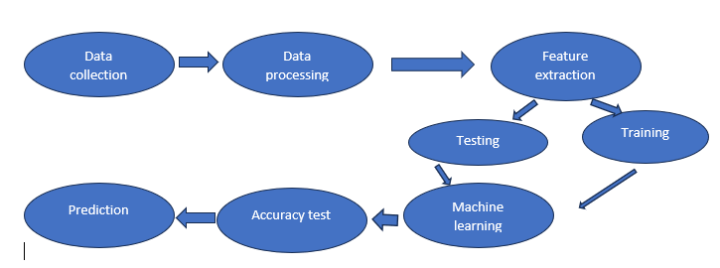
Research Design(Blueprint/Workflow)

Slide 13
Methodology
Data Collection: Historical data on tennis matches is collected from various sources, including online databases and specialized datasets like Kaggle. This data has details such as player rankings, match outcomes, tournament information, and betting odds.
Data Preprocessing: The collected data undergoes preprocessing, involving tasks such as handling missing values, removing duplicates, and ensuring data consistency. Feature engineering techniques are applied to derive new features and enhance predictive power.
Feature Selection: Relevant features influencing match outcomes are identified through statistical analysis, domain expertise, and feature selection methods. This step aims to select the most informative variables for model training.

Slide 14
Methodology
Model Selection: Suitable machine learning algorithms, such as Logistic Regression, Decision Trees, Random Forest are chosen for predicting tennis match winners.
Model Training: The selected machine learning models are trained using the preprocessed dataset. Model parameters are fine-tuned to optimize performance, ensuring that the models learn patterns and relationships present in the data.
Model Evaluation: The trained models are evaluated using metrics such as accuracy, precision, recall, and F1-score. This step assesses the models' performance in predicting tennis match outcomes and provides insights into their effectiveness.

Slide 15
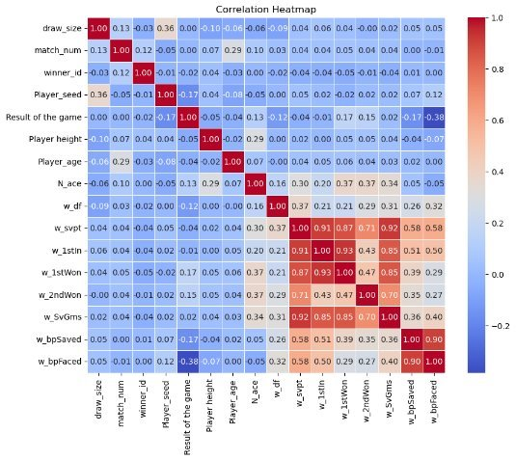
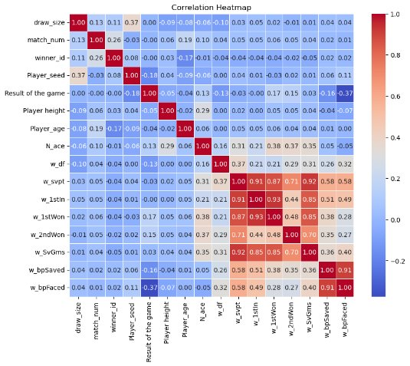
Data Visualization and Results
Plotted heatmaps to inspect the correlation by dropping null values and by replacing the null values with the mean.
From the correlation
we found out that w_bpfaced feature is some what higly correlated with our target variable i.e., result of the game.
we observe that by dropping the null or filling the null with mean values doesn't effect the correlation. so we decide to fill the null values with means
a. correlation by dropping null values
b. correlation by filling null values with the mean

Slide 16
MODEL DEVELOPMENT
Multi Linear regression
Multiple linear regression is a statistical method used to model the relationship between a dependent variable and two or more independent variables. It assumes a linear relationship between the dependent variable and each independent variable. The goal is to find the best-fitting linear equation that predicts the dependent variable based on the independent variables.

Slide 17
MODEL DEVELOPMENT
Multinominal regression
Multinomial logistic regression is a statistical method used for modeling the relationship between a categorical dependent variable with more than two categories and one or more independent variables. It extends logistic regression, which is used for binary classification, to handle multiple categories. The model estimates the probability of each category relative to a reference category, using separate sets of coefficients for each category.

Slide 18
MODEL DEVELOPMENT
Following are our approaches for developing multiple regression models
Linear regression
1. Multi linear regression using all numerical fetaures
2. Linear regression using highly correaled column (i.e., w_bpfaced) out of all numerical columns
3..Multi linear Regression with both higly correlated columns in numerical and categorical(i.e, w_bpfaced, Dominent_playing_hand respectively)
4. Multi linear Regression with all columns

Slide 19
MODEL DEVELOPMENT
Logistic Regression
1. Multinominal regression using all categorical features
2. Logistic regression using highly correaled column (i.e., Dominent_playing_hand) out of all categorical columns

Slide 20
Results (Linear Regression)
1. Multiple regression using all numerical features
Mean Squared Error: 0.171
R-squared: 0.314
2. Linear regression using highly correlated column (i.e., w_bpfaced) out of all numerical columns
Mean Squared Error: 0.203
R-squared: 0.186
3. Multiple regression with both higly correlated columns in numerical and categorical(i.e, w_bpfaced, Dominent_playing_hand respectively)
Mean Squared Error: 0.21
R-squared: 0.158
4. Multiple regression with all columns
Mean Squared Error: 0.198
R-squared: 0.208

Slide 21
Results (Logistic Regression)
5. Multinominal regression using all categorical features
Accuracy-0.52
Mean absolute error-0.48
6. Logistic regression using highly correlated column (i.e., Dominent_playing_hand) out of all categorical columns
Mean Absolute Error: 0.472
From all regression models we found out that the model developed using all numerical columns have low mean squared error which indicates it is good model compare to all other models in the regression

Slide 22
Hyper Parameter Tuning
Now we need to tune the hyperparameters for the model that gives low mean square error i.e., model developed using all numerical columns
Here our focus is to find the best alpha values for lasso and ridge regression using grid and random search
We use alpha as 0.1, 1, 10, 20 and 30
Out of all these alpha values we got lowest mean square error for alpha equal to 0.1 using lasso regression (L1 regularization)

Slide 23
RESULTS COMPARISON after hyper tunning
Metrics | Before Parameter Tuning | After Parameter Tuning
Mean Square Error | 0.1714 | 0.1634
R-Square Error | 0.3137 | 0.3457
Table : 1 Results Comparison

Slide 24

Decision Tree
Why decision tree
It is simple to understand and easy to interpret
It requires little data preparation
It can handle multiple out put problems
It is white box model

Slide 25
Process
Data preparation
As decision tree doesn’t required lots of data preparation but we made sure to remove the rows with NaN value which reduce the count from 1844 to 1743
Since decision tree only takes numerical values we changed the columns with strings to numerical using LabelEncoder from sklearn
Assigned “Result of the game” as target variable and rest of the 16 variables as independent variable
For first iteration we kept testing and training to 30% and 70%

Slide 26
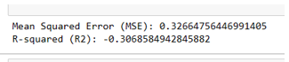
Model Execution
1st Iteration
With our first iteration it didn’t yield the good result.
MSE was 0.3266 which means on average, the squared difference between the actual and predicted values is relatively high.
Similarly R2 was -0.3068, which means my model is performing poorly and may be worse than simply predicting the mean of the dependent variable.

Slide 27
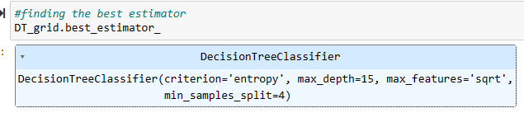
2nd iteration after optimizing the hyper parameter
For second 2nd iteration first we optimize the hyper parameter using RandomizedSearchCV from sklearn
It gave best estimater hyper parameter to be max depth = 15, criterion = entropy
With this parameter it gave model with accuracy as below
Train Accuracy - : 0.720
Test Accuracy - : 0.628

Slide 28

Random Forest
Why?
We have poor result form Decision tree
Random forest is more robust to outlier
It has lower variance and reduce the
overfitting
Data Preparation
We kept same data set up that we used for decision tree for method as well

Slide 29
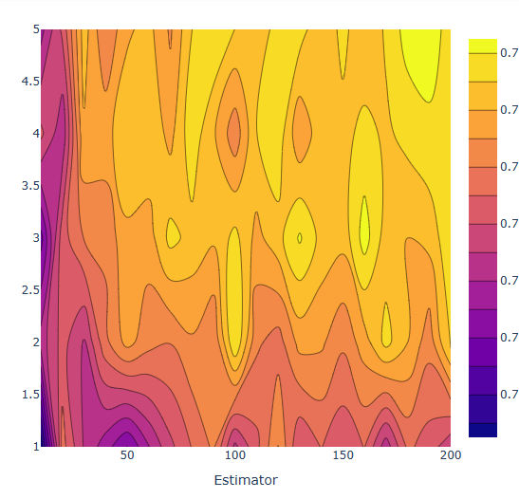
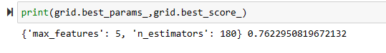
Hyper parameter tuning
For Random forest we did the hyper parameter tuning using GridSearchCV
It gave the best estimator with hyper parameter
max_feature : 5 and n_estimators: 180
This model had accuracy of 76%

Slide 30

Process
As decision tree, for this model as well have train to test data with split of 70% to 30%
Assigned Result of the game as target variable and rest as independent variable
For running the model we used RandomForestClassifier for skelarn

Slide 31

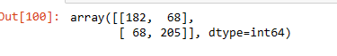
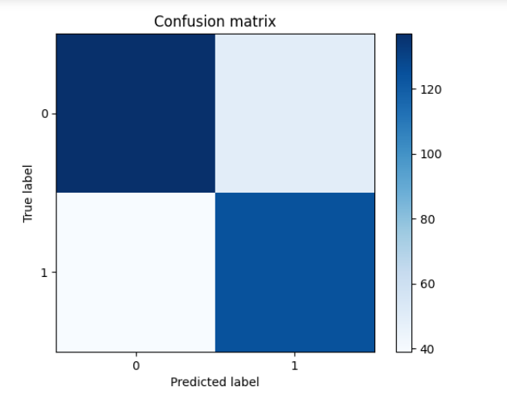
Accuracy check
In order to check the accuracy, we ran confusion matrix
True Negatives (TN): 182
False Positives (FP): 68
False Negatives (FN): 68
True Positives (TP): 205

Slide 32

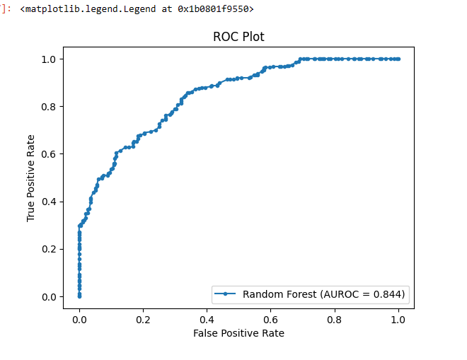
AUROC (Area Under the Receiver Operating Characteristic curve) to test the performance of the model
The Auroc gave the value of 0.84
the model has good discriminatory power
the model's performance is significantly better than random chance, but it may not be perfect
and over it is a good model that has a relatively good ability to distinguish between the two classes

Slide 33
Conclusion
Among all the models we ran, Random forest yield the best result with accuracy of 76%.
Even though linear regression and logistic regression has lesser error but these models with high volume of data can be less reliable.
More over, our research has demonstrated superior performance compared to the study conducted by Yue, Chou, Hsieh, and Hsiao (2022) in forecasting tennis matches via the Glicko model. As per the article Glicko model had accuracy of 74% but our study has slightly more than it.

Slide 34
References
Yue, J. C., Chou, E. P., Hsieh, M. H., & Hsiao, L. C. (2022). A study of forecasting tennis matches via the Glicko model. PloS one, 17(4), e0266838. https://doi.org/10.1371/journal.pone.0266838
Herbinet, C. (2018). Predicting football results using machine learning techniques. MEng thesis, Imperial College London.
Joseph, A., Fenton, N. E., Neil, M. (2006). Predicting football results using Bayesian nets and other machine learning techniques. Knowledge-Based Systems, 19(7), 544-553.
Prasetio, D. (2016, August). Predicting football match results with logistic regression. In 2016 International Conference On Advanced Informatics: Concepts, Theory And Application (ICAICTA) (pp. 1-5). IEEE.
Baboota, R., Kaur, H. (2019). Predictive analysis and modelling football results using machine learning approach for English Premier League. International Journal of Forecasting, 35(2), 741-755.

Slide 35
References
Hvattum, L. M., Arntzen, H. (2010). Using ELO ratings for match result prediction in association football. International Journal of forecasting, 26(3), 460-470.
Sipko, M., Knottenbelt, W. (2015). Machine learning for the prediction of professional tennis matches. MEng computing-final year project, Imperial College London, 2.
Guyon, I., Elisseeff, A. (2003). An introduction to variable and feature selection. Journal of machine learning research, 3(Mar), 1157-1182. 6
Solanki, S., Jakir, V., Jatav, A., Sharma, D. (2022). Prediction of tennis match using machine learning. Int. J. Progress. Res. Eng. Manag. Sci, 2, 5-7. Learning, M. (2017). Final Project Report: Real Time Tennis Match Prediction Using Machine Learning.

Slide 36
THANK YOU

